Slide 1


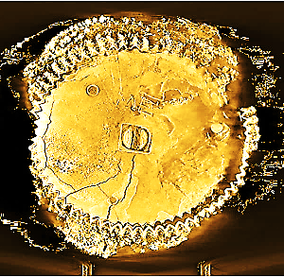
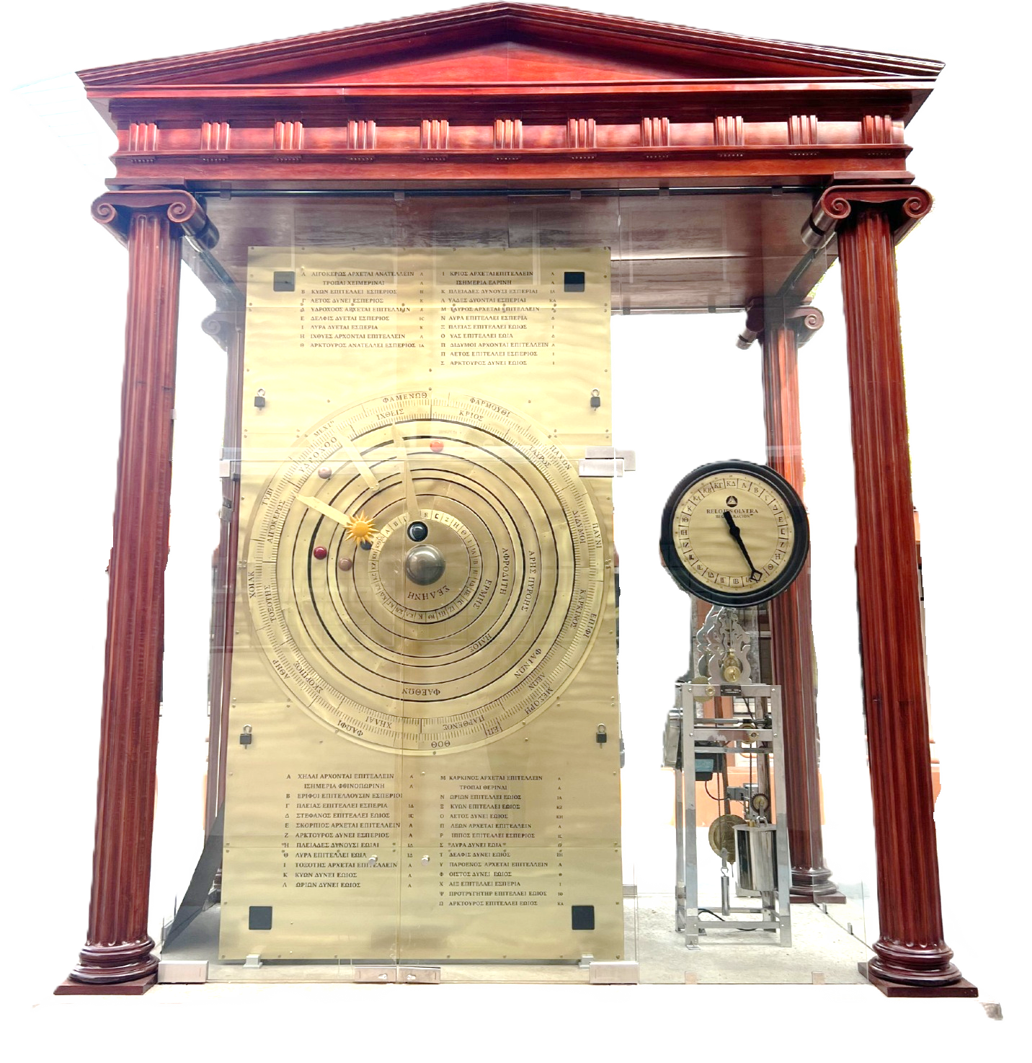
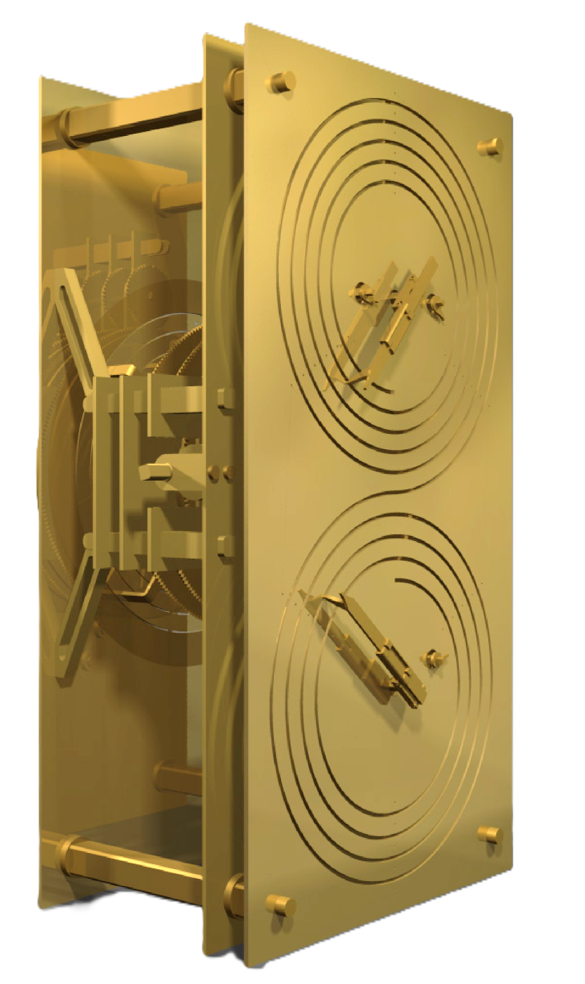
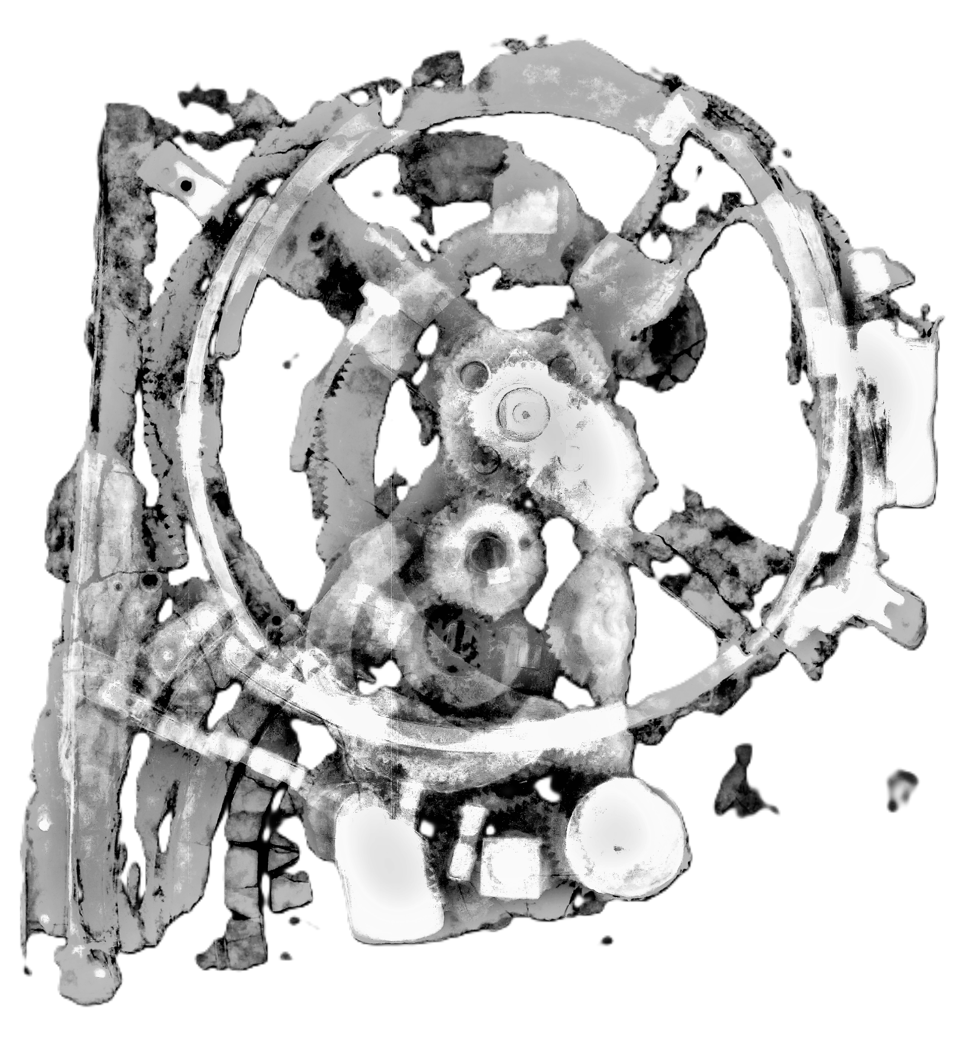
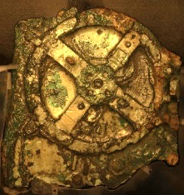
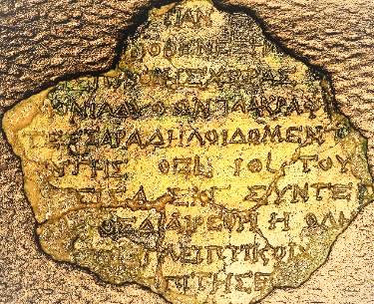
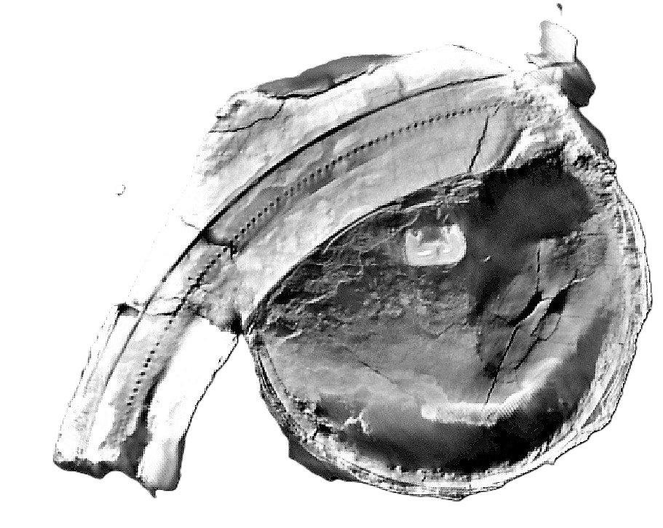
Thursday, October 2, 7:00 pm US CST
Dyer Observatory,
1000 Oman Drive, Nashville, TN
The Hellenic Institute of Cultural Diplomacy-USA and Vanderbilt University's Dyer Observatory
present the widely anticipated
Antikythera Mechanism lecture
rescheduled from the weather cancelation in April.
Join two of the world's foremost scholars
-Dr. Xenophon Moussas and Dr. Julio Sausedo Morales –
in live stream on site at Dyer ($10 Eventbrite)
https://www.eventbrite.com/e/special-lecture-and-viewing-night-the-antikythera-mechanism-tickets-1677680219699?aff=oddtdtcreator
or view free from anywhere on Vanderbilt's YouTube channel.
https://www.youtube.com/@dyerobservers/streams
Video welcome by HICD-USA President, DeeGee Lester
Event introduction by Dr. Billy Teets, Director, Vanderbilt Dyer Observatory.
Dr. Moussas : The Antikythera Mechanism
and the laws of physics,
will explore the ancient mechanism.
Dr Saucedo Morales: Construction, impact
and follow-up of the
“Monumental Antikythera
Mechanism of Hermosillo” (MAMH).
will introduce the
monumental and fully-functional
Antikythera Mechanism at
Universidad de Sonora, Mexico.
The Hellenic Institute of Cultural Diplomacy, USA

Slide 2
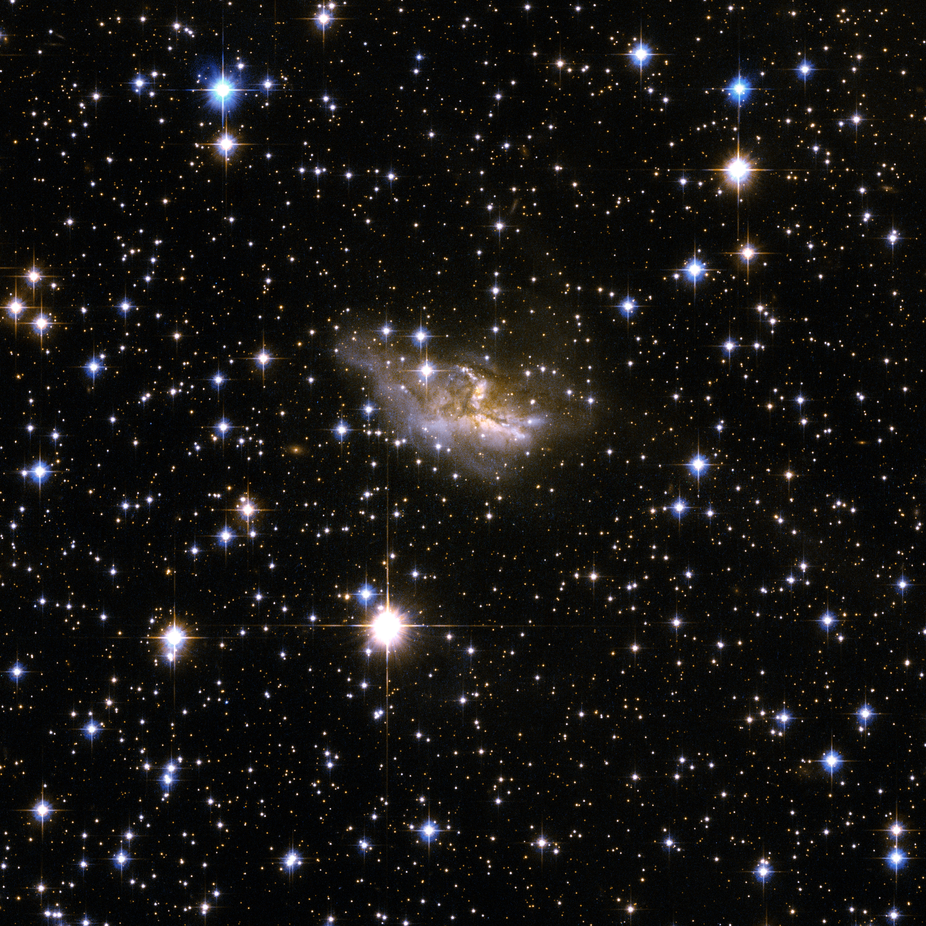
Thursday, October 2, 7:00 pm US CST
Dyer Observatory,
1000 Oman Drive, Nashville, TN
The Hellenic Institute of Cultural Diplomacy-USA and Vanderbilt University's Dyer Observatory
present the widely anticipated
Antikythera Mechanism lecture
rescheduled from the weather cancelation in April.
Join two of the world's foremost scholars
-Dr. Xenophon Moussas and Dr. Julio Sausedo Morales –
in live stream on site at Dyer ($10 Eventbrite)
https://www.eventbrite.com/e/special-lecture-and-viewing-night-the-antikythera-mechanism-tickets-1677680219699?aff=oddtdtcreator
or view free from anywhere on Vanderbilt's YouTube channel.
https://www.youtube.com/@dyerobservers/streams
Video welcome by HICD-USA President, DeeGee Lester
Event introduction by Dr. Billy Teets, Director, Vanderbilt Dyer Observatory.
Dr. Moussas : The Antikythera Mechanism
and the laws of physics,
will explore the ancient mechanism.
Dr Saucedo Morales: Construction, impact
and follow-up of the
“Monumental Antikythera
Mechanism of Hermosillo” (MAMH).
will introduce the
monumental and fully-functional
Antikythera Mechanism at
Universidad de Sonora, Mexico.
The Hellenic Institute of Cultural Diplomacy, USA

