Slide 1
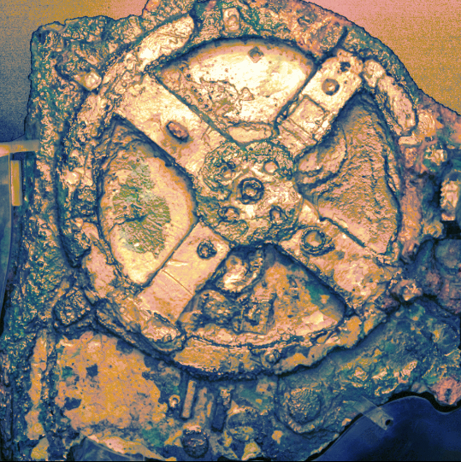
Proposal: Antikythera Mechanism at LA28 Olympic Opening Ceremony
Celebrating Innovation from Antiquity to the Future
http://users.uoa.gr/~xmoussas/1_Antikythera-Mechanism_Olympic-Games-Proposal_2028/

Slide 2
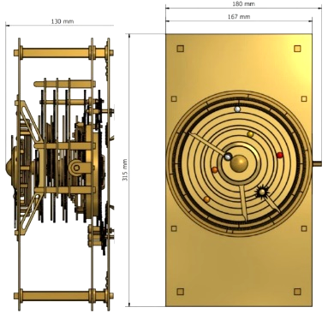
Introduction
We propose a historic and inspirational addition to the 2028 Olympic Games Opening Ceremony in Los Angeles: a presentation of a model of the Antikythera Mechanism—the world’s first known analog computer.
http://users.uoa.gr/~xmoussas/1_Antikythera-Mechanism_Olympic-Games-Proposal_2028/

Slide 3
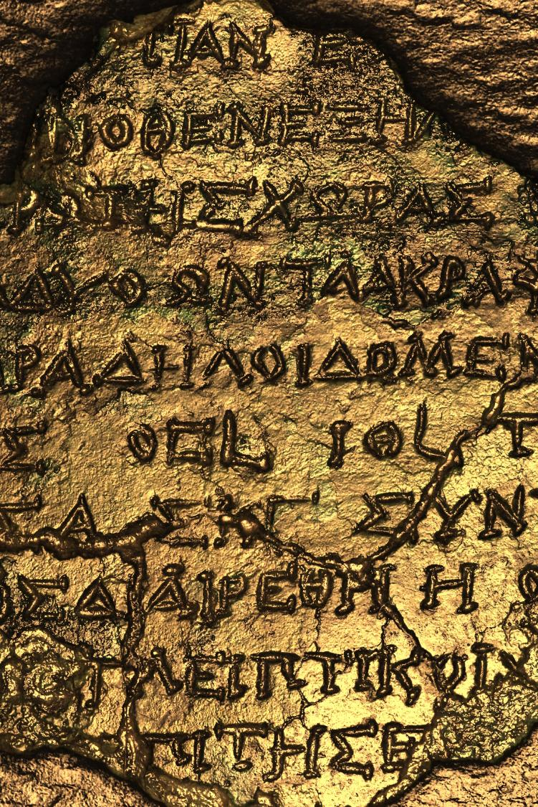
Why the Antikythera Mechanism?
• Ancient Greek device used to calculate dates of Olympic and Panhellenic Games
• Symbol of humankind’s timeless pursuit of knowledge and understanding
• Represents fusion of innovation, ingenuity, science, culture, and history and teaches the young

Slide 4
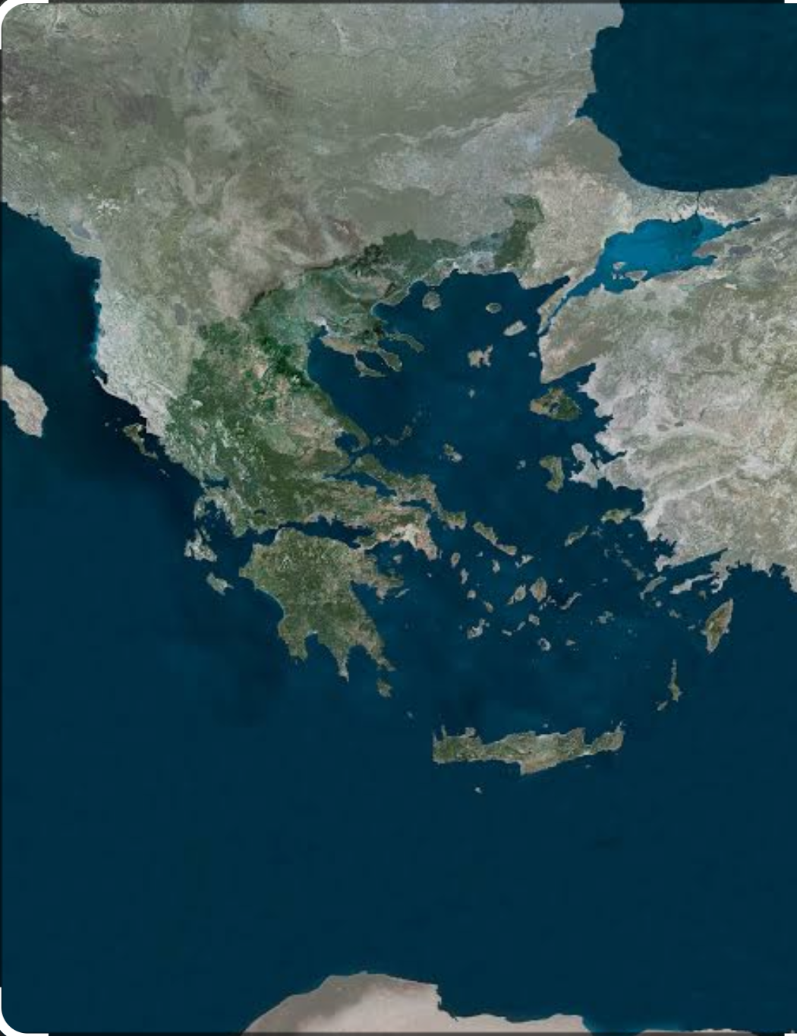
Προβάλλει την
Ελλάδα

Slide 5
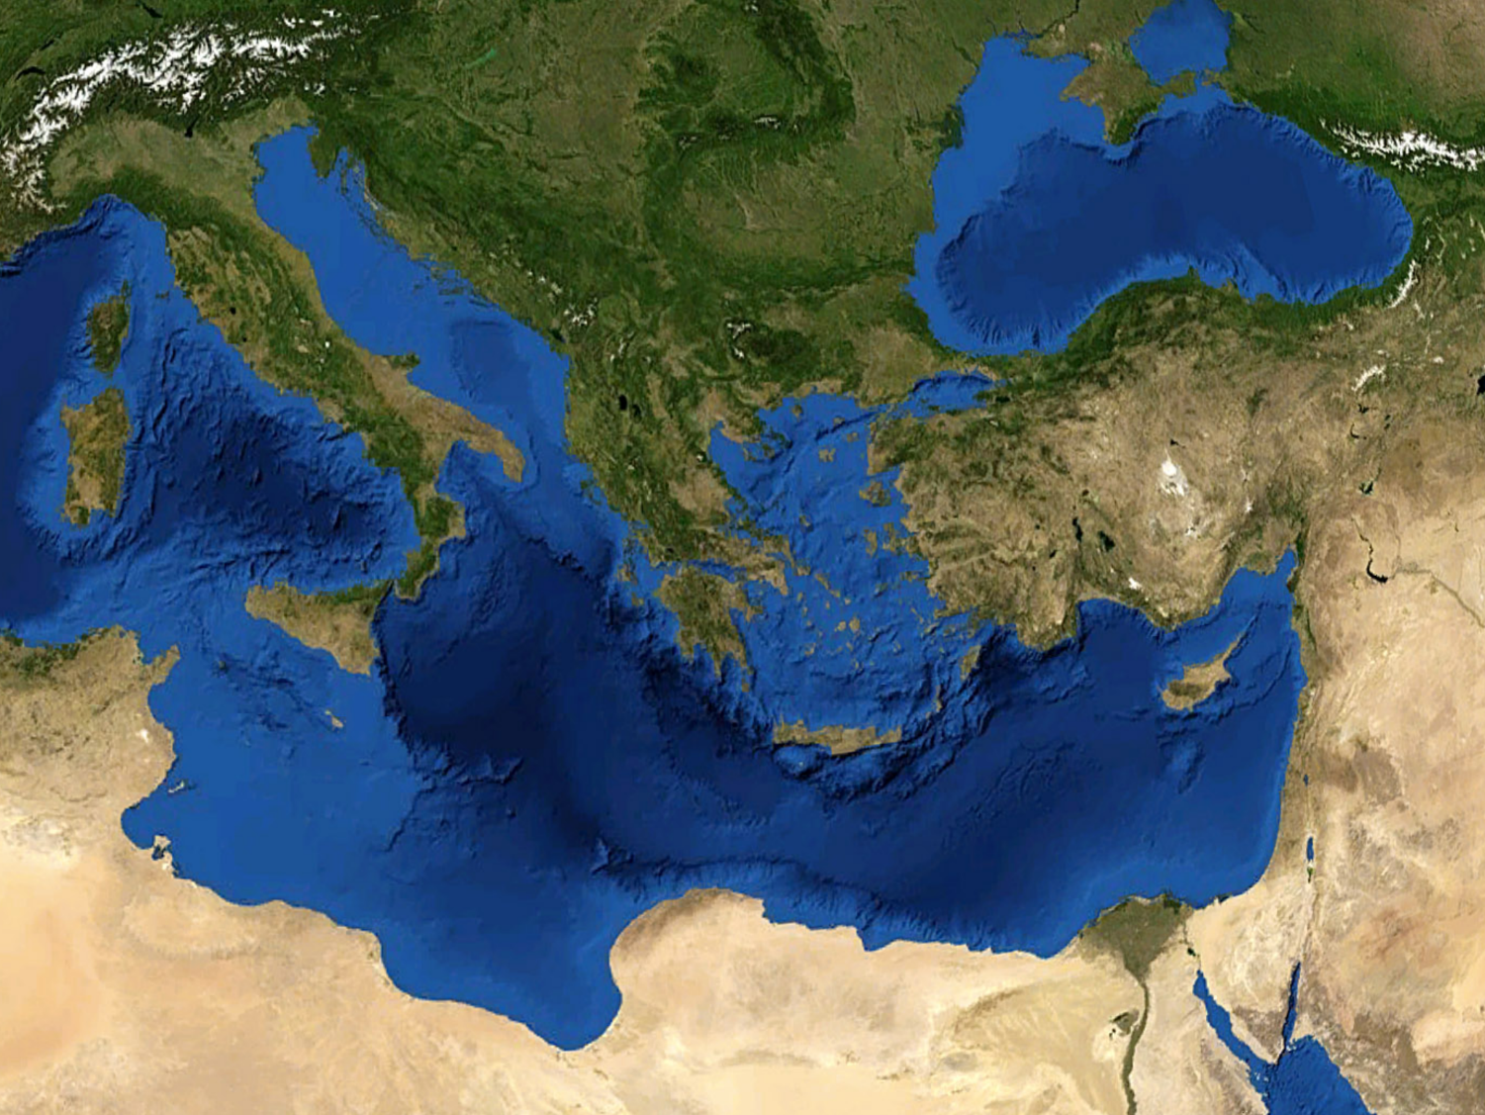
Θα προβάλλει την Ελλάδα για πάντα

Slide 6
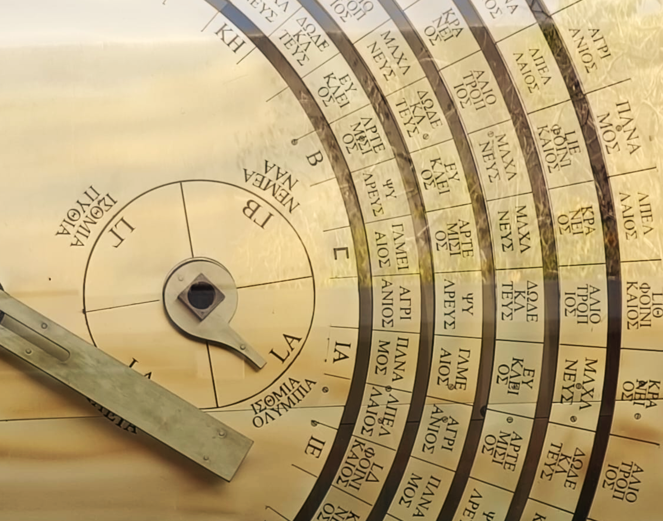
Why LA28?
• A perfect place to connect ancient knowledge with modern achievement
• Reinforces Olympic values of excellence, inspiration, and education
• Los Angeles is a beacon of innovation, creativity, and technology

Slide 7
Why LA28?
• A perfect place to connect ancient knowledge with modern achievement
• Reinforces Olympic values of excellence, inspiration, and education
• Los Angeles is a beacon of innovation, creativity, and technology
Look what it says here

Slide 8
Why LA28?
• A perfect place to connect ancient knowledge with modern achievement
• Reinforces Olympic values of excellence, inspiration, and education
• Los Angeles is a beacon of innovation, creativity, and technology
LA in ancient Greek means 1st year of the Olympiad

Slide 9
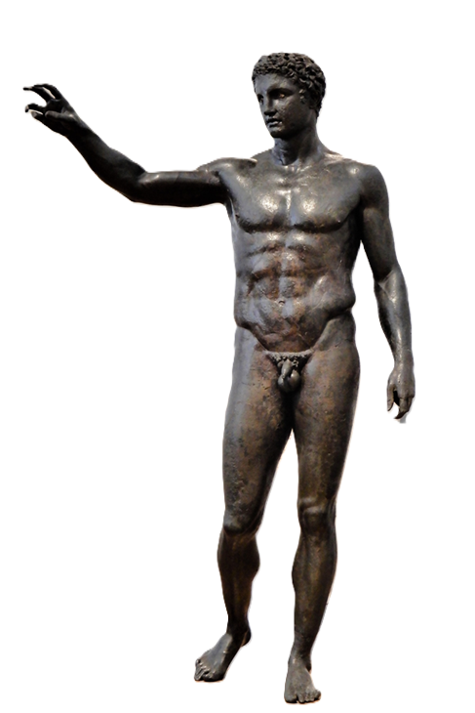

Key Moment in Ceremony
• An athlete or key figure presents the Antikythera Mechanism model on stage
• Symbolizes unity of past and future, tradition and innovation
• Complements Olympic flame as a symbol connecting generations
http://users.uoa.gr/~xmoussas/1_Antikythera-Mechanism_Olympic-Games-Proposal_2028/

Slide 10
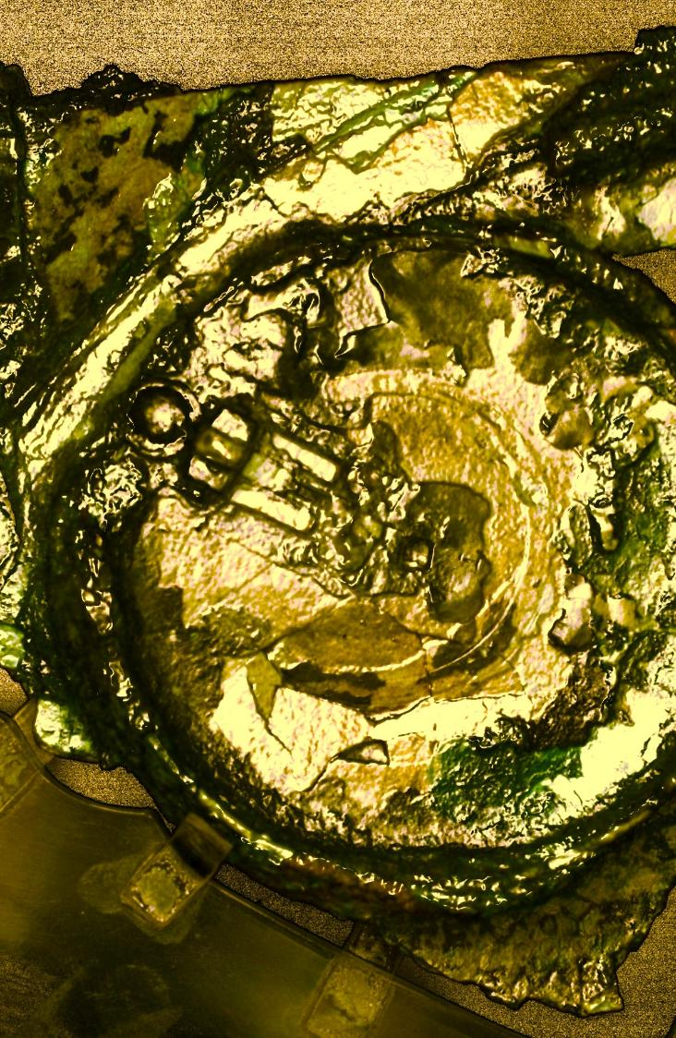
Broader Impact
• Honors ancient Greek contributions to science and global culture
• Promotes STEM education and global collaboration
• Offers a timeless story of human ingenuity

Slide 11
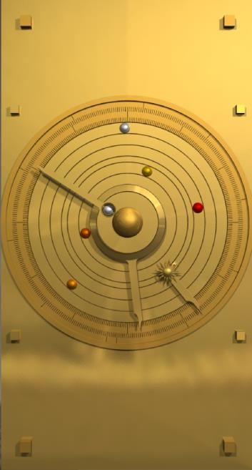
Support & Next Steps
Write articles
Moon
Sun
http://users.uoa.gr/~xmoussas/1_Antikythera-Mechanism_Olympic-Games-Proposal_2028/

Slide 12
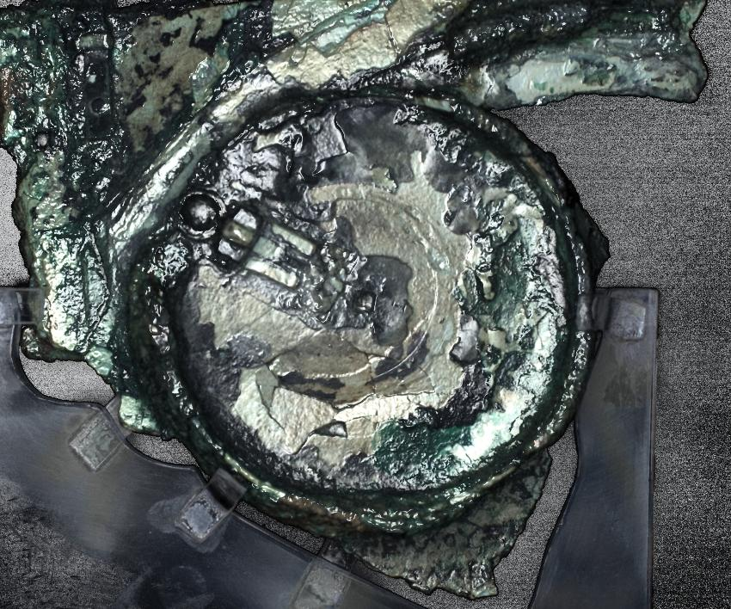
Support & Next Steps
Radio
&
TV
http://users.uoa.gr/~xmoussas/1_Antikythera-Mechanism_Olympic-Games-Proposal_2028/

Slide 13
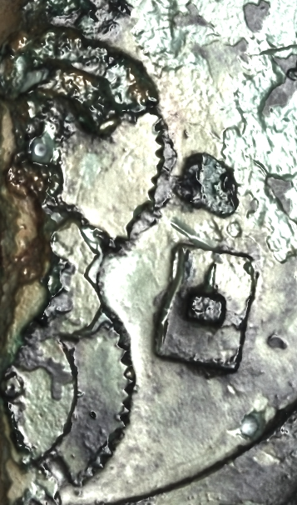
Support & Next Steps
Letters and discussions with Olympic Committees, Politicians, Academics, Athletes, influencers, the People
http://users.uoa.gr/~xmoussas/1_Antikythera-Mechanism_Olympic-Games-Proposal_2028/

Slide 14
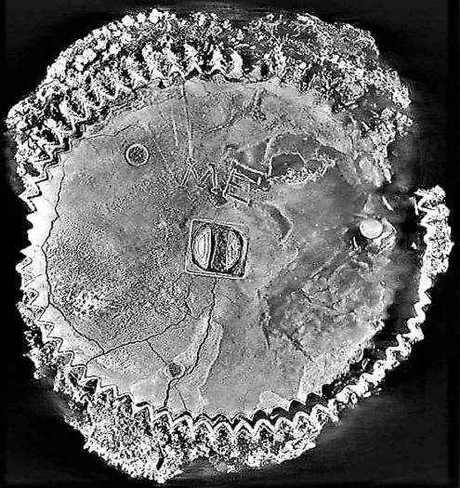
Support & Next Steps
• Draft letters of support available
http://users.uoa.gr/~xmoussas/
http://users.uoa.gr/~xmoussas/1_Antikythera-Mechanism_Olympic-Games-Proposal_2028/

Slide 15
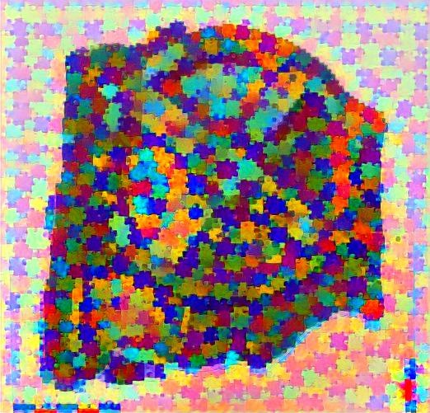
Support & Next Steps
• Technical and visual documentation
http://users.uoa.gr/~xmoussas/
xdmoussas@gmail.com
• We welcome the opportunity to discuss this proposal further

Slide 16
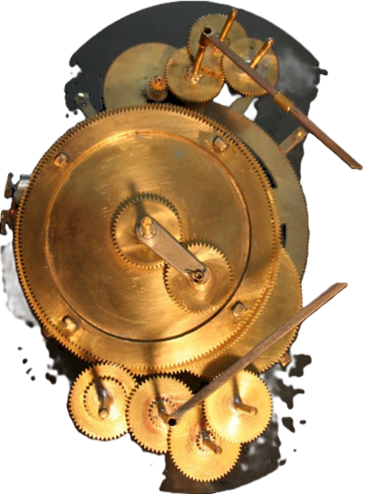
Thank You
Please promote this proposal
Send appropriate letters to the officials.
For more information or
to express interest in collaboration:
Contact:
IOANNA LAZAROU or XENOPHON MOUSSAS
Email: Info@greekradiofl.com xdmoussas@gmail.com
http://users.uoa.gr/~xmoussas/
Let us celebrate innovation—ancient and modern—together at LA28.
http://users.uoa.gr/~xmoussas/1_Antikythera-Mechanism_Olympic-Games-Proposal_2028/

