Slide 1
Law School
Themes in the Philosophy of Private Law (I)
Philippos Vassiloyannis, Associate Professor

Slide 2
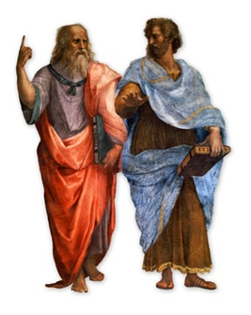
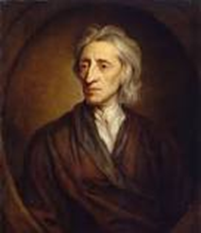
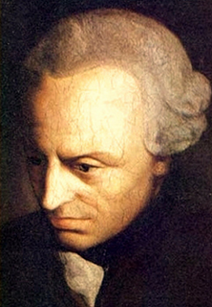
1st Lecture
Remarks on the Philosophy of (Private) Law
A Crisis of Orientation of the (Current) Private Law Doctrines
Distributive and Corrective Justice: Correlativity and Personality
DJ: I cannot better my position without bettering yours position…
CJ: primary moral and political reasons for our co-existence as free and equal persons
2nd Lecture
Legal Order as a Chain Novel: The Priority of Private Law Principles
The Scandal of Original Ownership:
Lockean and Kantian Justifications
Nozickean Justice: The Minimal State

Slide 3
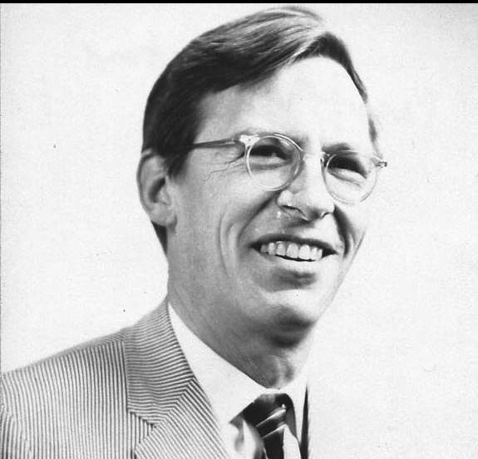
Some Remarks on the Philosophy of (Private) Law
a motto: “It is easy to kill a subject by demanding too much of it early on;
a subject needs to be guided by big intuitive ideas, particularly at the start...
It is a delusion to think that rigorous analysis in a small area unguided by a large idea is of much value.
One does not understand even a small thing in this way”
(John Rawls, 1964, to students in his moral philosophy course)
two conceptions
(1) philosophy of law as a subfield or as applied moral and political philosophy
but what if law = the moral and political reasons justifying public coercion?
law = moral maximum in regard to public coercion
minimum its contents
a “compulsory moralism”?
philosophy of law as an elementary part or aspect of moral and political philosophy

Slide 4
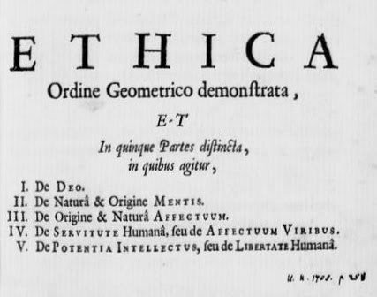
(2) philosophy of law as a foundation of an entire discipline
or as a moral (“Euclidean”) geometry
juris prudentia est vera philosophia…
but:
no first principles
no last words
philosophy of law in mediis rebus
(a) no abstraction for philosophy’s sake
(b) the deeper the legal disagreement, the higher the philosophical abstraction
(c) no royal roads
(d) reflective and critical

Slide 5
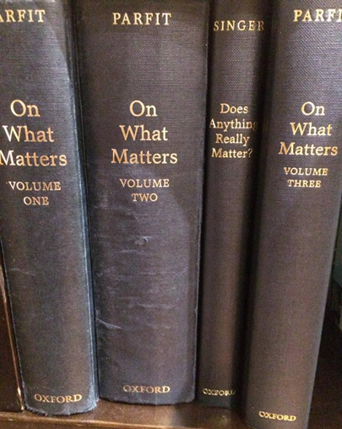
disagreeing and (practical) normativity
reasons for action: considerations that counts in favour of x
e. g., in a Burning Hotel case, you will die unless you jump from your hotel
window into a canal: You ought to jump
no subjective
“2 + 2 = 1”
considered judgments
↑
“borrowed things should be returned to the lender”
↓
principles
reflective equilibrium judgements
a matter of principle
e. g., you borrow a book from a friend, and then discover that it has been stolen from a
public library. You have no reason at all to return it to the lender. But, you have a duty to
inform him about your rendering the book to the library. The borrower’s initial strong
duty to return the book to the lender is substituted by a weaker duty (just to inform him)

Slide 6
a pure theory of law (as a counter-example)
norm as a fundamental concept
legal and factual (or empirical)
validity and efficacy
(yes/no) (more/less)
basic norm
(no positive) and moral relativism
a legal pyramid (otherwise infinite regress)
constitution a Nazi Constitution
laws as acts of parliament etc
administrative & judicial acts etc

Slide 7
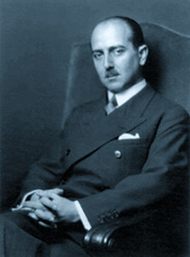
the impossibility of application
facts → norms
normativity as a matter of decision-making
the unimportance of interpretation
norms → facts
Hans Kelsen (1881-1973)
application and interpretation of law as creation of law
will (volition) and cognition
the impossibility of a legal syllogism:
(a) tortfeasors are liable to pay full reparative damages to those whom they tortuously injure
(b) Amy tortuously injured Bob to the tune of €50
(c) therefore, Amy is liable to pay Bob €50 in reparative damages
no priority of legislation in private law
= a judge-made law?

Slide 8
common law as a matter of practical wisdom
a thought-experiment
from the protection of ownership
to the protection of possession
analogical judgment: invention or discovery?
a ridiculous logical syllogism: all humans are immortal
Socrates is human.
therefore, Socrates is immortal
an introductory conclusion: legal characterization
or the priority of reasons for action over to norms
Bob →← Amy
Amy parks her car in Bob’s parking lot
keeps the keys of the car in her pocket
therefore, a bailment or a hire?

Slide 9
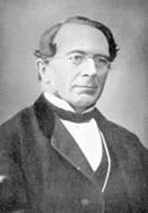
A Crisis of Orientation of the (Current) Private Law Doctrines
sociological jurisprudence v. liberal jurisprudence
economic analysis of law corrective justice theories
jurisprudence of interests
Rudolph v. Jhering
v. legal conceptualism
(Begriffsjurisprudenz)
(1818-1892)
self-evident definitions and (formal) logic
a methodology controversy
balancing of interests
legal pragmatism (or realism): interest as a basic concept

Slide 10
(a) a smoke nuisance?
(cf., Bryant v. Lefever [1879])
Amy and Bob are neighbors…
sociological jurisprudence:
both parties
balancing the interests
considering the consequences
maximizing
liberal jurisprudence: by a unilateral act
damage does presuppose violation of a right
Amy has no claim against Bob
the right to fence is inherent to ownership

Slide 11
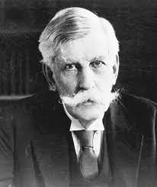
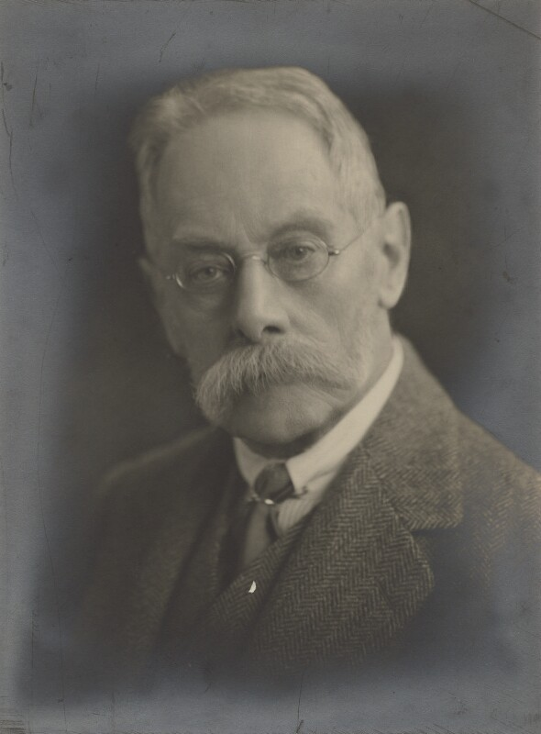
(b) efficient breach of contract?
“The Path of the Law” (1897)
Oliver Wendell Holmes Jr. (1841-1935) Sir Frederick Pollock (1845-1937)
“if the obligation is, as you maintain, only alternative,
how can it be wrong to procure a man to break his contract...?”
The Pollock-Holmes Letters 1, p. 80
(cf. Adras Building Material v. Harlow & Jones [1988])
Bob had agreed to sell steel to Amy, but when the price of steel spiked,
Bob instead sold the steel stored for that purpose to Carol
sociological jurisprudence: Value is a matter of taste, and Amy’s position, according to her past preferences, has not worsened. My gain is not a loss of others
liberal jurisprudence: Contract is a transfer of ownership. Bob intervened in an Amy’s affair. Bob and Carol have ignored Amy as a free and equal person

Slide 12
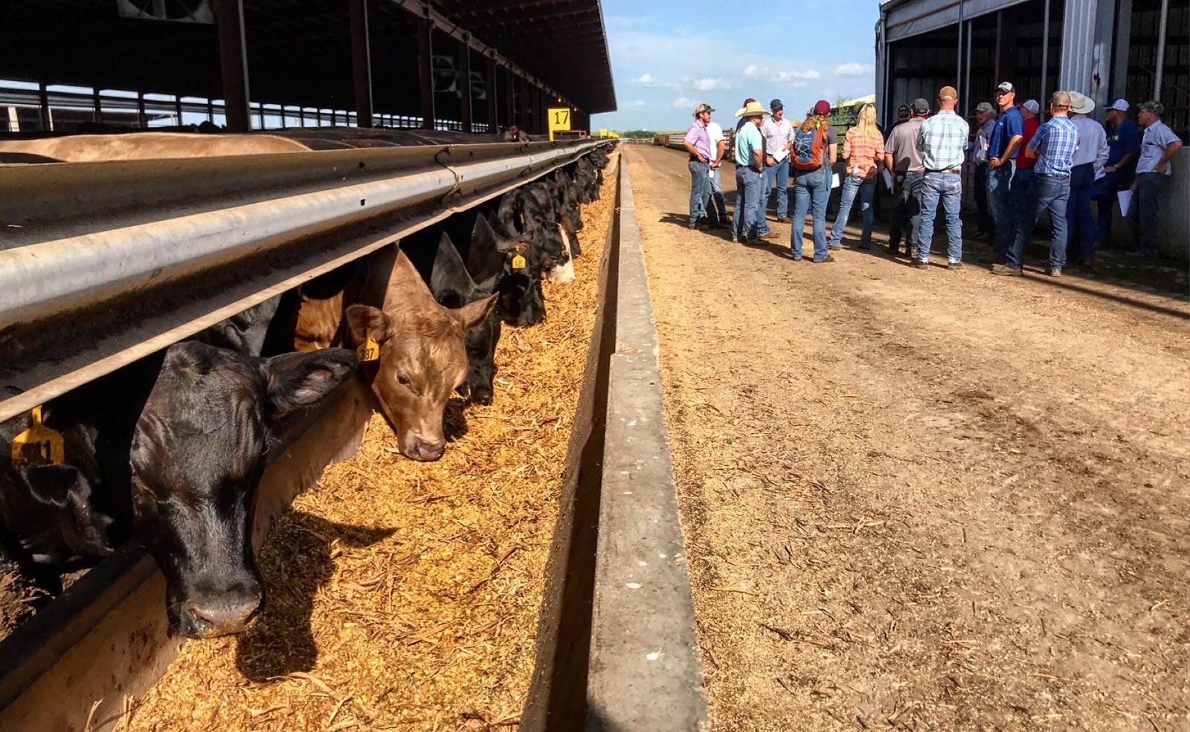
(c) a smells nuisance
(cf. Spur Industries v. Del E. Webb Development [1972])
Bob is the operator of a cattle feedlot
built in what had long been an agricultural district
Amy is a real estate developer…
As the development grew…
sociological jurisprudence: Amy is entitled to an injunction
But, she should also compensate Bob for…
liberal jurisprudence: Bob’s use of land becomes not ordinary
Compensation always presupposes an illegal act
Development in question was not illegal
Urban plan is a matter of administrative law

Slide 13
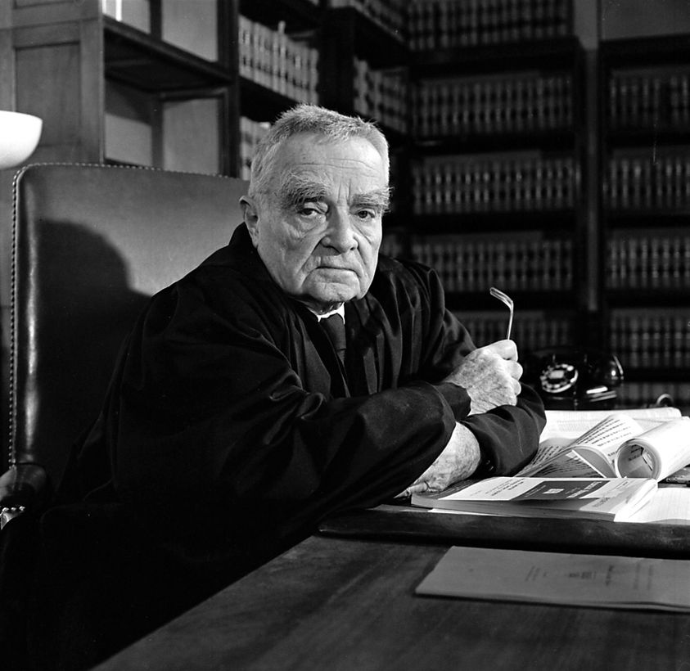
(d) negligence
Learned Hand's formula
sociological jurisprudence: "if the probability be called P;
the injury, L; and the burden, B;
liability depends upon whether B is less
than L multiplied by P: i.e., whether B < P * L»
159 F.2d 169 (1947) at 173
(1872-1961)
liberal jurisprudence: It is the risk, not the cost of eliminating it that grounds Amy’s liability.
Negligence exists when there is a breach of a duty of care.
Probability of an accident is relevant, but cost is irrelevant.
If the duty of (reasonable) care is respected, the loss lies where it falls.

Slide 14
(e) pandemic reasons
impossible for Amy to keep a contract with Bob…
sociological jurisprudence: Amy’s has in principle a right to ask a judge to adjust the contract to the new conditions
liberal jurisprudence: Pacta sunt servanda, unless the contract is frustrated by an act of God. Courts do not make contracts for the parties
etc., etc., …
two antagonistic justifications?
is “sociological” jurisprudence illiberal?
“19. We demand that Roman law […] be replaced by [medieval] German common law”

Slide 15
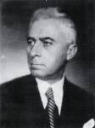
a methodological decline
an ideal textbook:
(a) the normative problem: no rule
(b) the solution: the rule in question
(c) interpretation and application
no authoritative verbal meaning
no authoritative legislative intention
a codified theory
“The contract is concluded as of the time that the declaration of acceptance of
the offer has reached the offeror” (article 192 of Greek Civil Code)
no external manifestation theory (“I accept it”)
no mail-box theory
only the best theory Georgios Balis (1879-1957)

Slide 16
Distributive and Corrective Justice
I will tell you about that case. There were two boys, a big boy and a little boy, and the big boy’s coat was small and the small boy’s coat was huge. So the big boy stripped the little boy and gave him his own small coat, while he put on the big one himself. Now in giving judgment I decided that it was better for both parties that each should have the coat that fitted him best. But I never got any further in my sentence, because the master thrashed me here, and said that the verdict would have been excellent if I had been appointed to say what fitted and what did not, but I had been called in to decide to whom the coat belonged, and the point to consider was, who had a right to it: Was he who took a thing by violence to keep it, or he who had had it made and bought it for his own? And the master taught me that what is lawful is just and what is in the teeth of law is based on violence, and therefore, he said, the judge must always see that his verdict tallies with the law

Slide 17
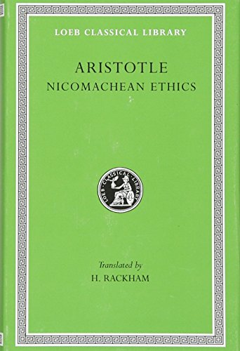
• distributive justice
GA GB GC
— = — = —
CA CB CC
G: the dividable good
C: the criterion (needs, contribution etc.)
Amy, Bob, Carol: the receivers

Slide 18
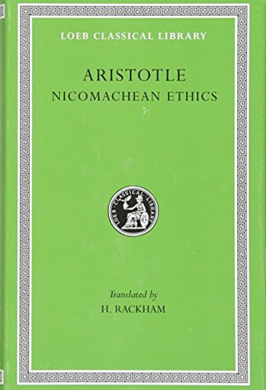
corrective (or non-distributive) justice
Amy ←→Bob Carol
t1 …10 …10 …10
t2 …08 → …12 …10
t3 …10 ← …10 …10
t4 …08 → …10 …10
t5 …10 ← …08 …10

Slide 19
stereotypes
ancient ethics modern morality
(a) basic question
What is the good life? What should I do?
What is happiness and human flourishing?
(b) The most important
Personal perfection Universal moral obligations
(c) The object of concern
Virtuous man Actions and consequences
(d) The central concepts
Prudence, (objective) good Duty (or obligations), right,
(subjective) interest
(e) The goal of human action:
Objective (happiness) Subjective: No God, No nature
(f) Individual-political community /society
Priority of political community: status Priority of individual: contract

Slide 20
correlativity and personality
voluntary transaction (synállagma)
promise = consideration
v.
freedom of transactions
consent
jus
(a) right (moral power)
(b) objective norm (e.g., the traffic rules)

Slide 21
a trust relationship
Amy ←→ Bob
a constitutional right to abortion
liberty
conscientious objection
claim ←→ obligation
life
health
1%

Slide 22
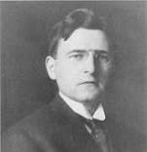
a typology
Amy ←→ Bob
Carol → ? (the Perruche affair)
Wesley Newcomb Hohfeld
(1879-1918)

Slide 23
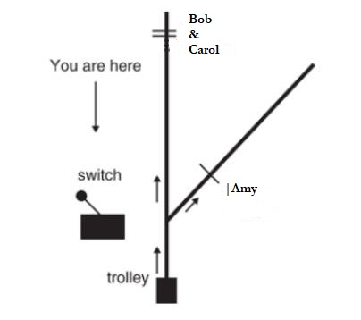
trolley problems
natural duties
not to harm and to help others
negative positive
priority of negative duties
ought implies can
each counts for one, more count for more
special reasons?

Slide 24
Toronto’s School

