Slide 1
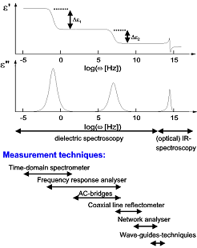
Introduction to
Broadband Dielectric
Spectroscopy BDS
A.N. Papathanassiou
Asst. Professor, N.K.U. A.
(http://http://scholar.uoa.gr/antpapa/home

Slide 3
THE MATTER IN STATIC ELECTRIC FIELDS
Polarization
If ρ_{FREE} polarize the dipoles: Displacement
(related with electric flux (Gauss law))
related with force on charges
Linear response:
Susceptibility
Dielectric constant
(tensor)

Slide 4
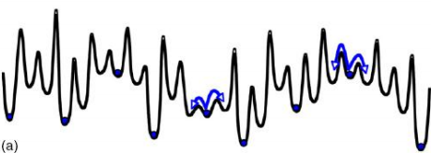
Correlation of macroscopic to molecular properties
Induced polarization:
Polarizabilities
Electronic
Atomic
Permanent electric dipole rotation
Spatial localization of ‘free’ charges
Electrode polarization:
Experimental and
Computational
suppression
Space charge
Interfacial
Disorder induced localization

Slide 5
Dielectric relaxation
External ‘force’ E
Equilibrium state 1
Equilibrium state 2
Correlation between spatial and temporal scales
Linear Response Theory (LRT):
Response proportional to perturbation

Slide 6
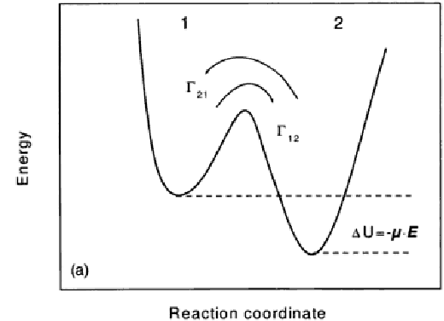
Extraction of Debye equations from microscopic principles
Work=bFcosθ
=beEcosθ
Electric field modifies the potential, but too weak to push charges
ΔG>>kT
Fluctuations / thermal vibrations are needed.

Slide 7
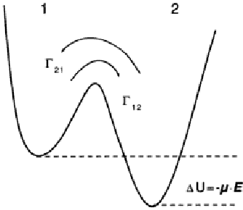
Transition rate
State 1
State 2
Γ₁₂
n₁
n₂
Γ₂₁
Thermal fluctuatioons
Perturbation
Work=bFcosθ=beEcosθ
n₁~exp{(-ΔG-ΔU)/kT}
n₂~exp{(-ΔG+ΔU)/kT}

Slide 8
Switch off E, at t=0
Γ
dn₁/dt= - dn₂/dt
τ_{ε}=1/2Γ
(Debye equation)

Slide 9
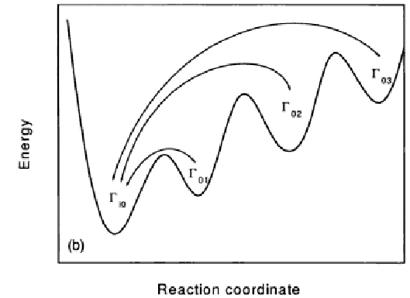
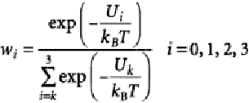
Assymetric potential minima

Slide 10
Distributed relaxation time model
Correlations: The stretched exponential KWW model
Relaxation:
P(t)=F(t)E_{o}
Debye system;
Identical, with τ_{ε}=w⁻¹
Single relax. time model: dF(t)/dt= - wF(t)
Real system;

Slide 11
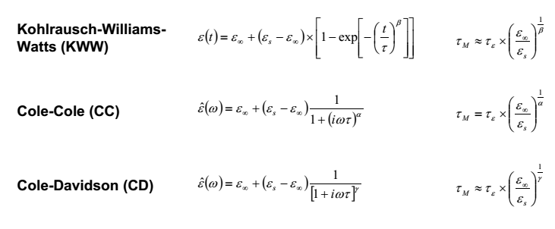

Slide 12
Dielectric relaxation time
Time-scale for molecular motion (molecular dynamics)
or spatially localized electric charge flow.
h^{act}
υ^{act}
Its correlation with physical quantities of the system
depends on the physical picture and modeling of the atomic (molecular) motion
g^{act}

Slide 13
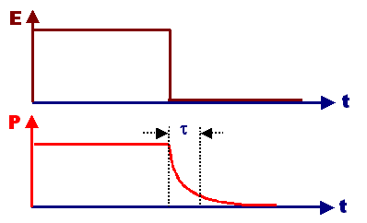
Dielectric Functions
Relaxation function F(t)
Response function f(t)
Susceptibility χ*(ω)
δ-function ‘force’
Time-domain experiments
Frequency domain
ω=2πf

Slide 14
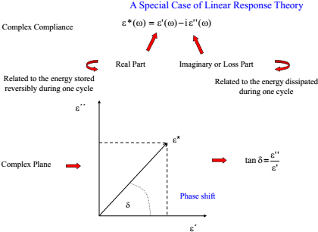

Slide 15
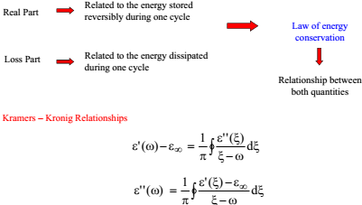

Slide 16
E
t

Slide 17
Phenomenological Theory
Phenomenological Theory
Polarization term
Polarization term
E
t
0
s
Superposition principle:
Superposition principle:
ΨΨ(t) = ?
(t) = ?
Dielectric decay function
Dielectric decay function

Slide 18
Single relaxation time model (Debye)
Eo
Assumption: Single τ_{ε}
Previous slide:
d/dt
AC harmonic voltage:

Slide 19
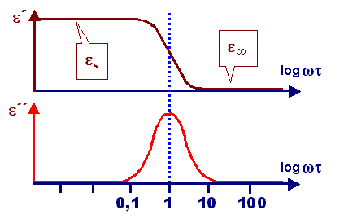
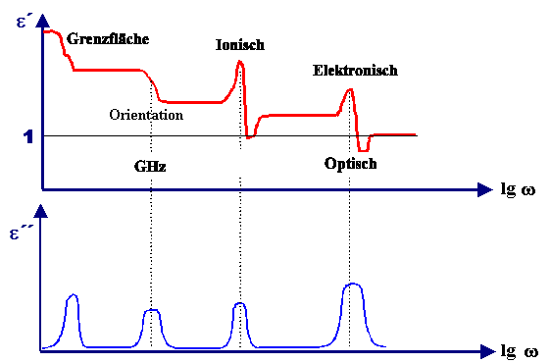

Slide 20
DC conductivity traced by BDS
Empty (parallel) capacitor
(Q, V in phase)
out of phase to V(ω) (no losses)
Capacitor with material of DC conductivity σ_{DC}
I=GV in phase with V
Conductance G=σ_{DC}Α/L
C=ε_{o} ε Α/L
ε*(ω)=ε’-jε’’
ε
Straight line with slope –1 in a log-log plot

Slide 21
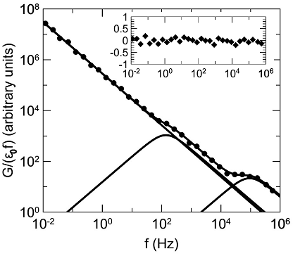
A.N.Papathanassiou et al APL (2013)

Slide 22
Localizec electric charge flow in disordered material:
‘free’ charges in non-polar dielectrics
A.N. Papathanassiou, I. Sakellis and J. Grammatikakis Universal frequency-dependent ac conductivity of conducting polymer networks Appl. Phys. Lett. 91, 122911 (2007)
L_{c}.=υ/ω_{c}
Distribution in lengths f(logL)
Generalization:
Chains → Pathways of various lengths accesible to transporting charges

Slide 23
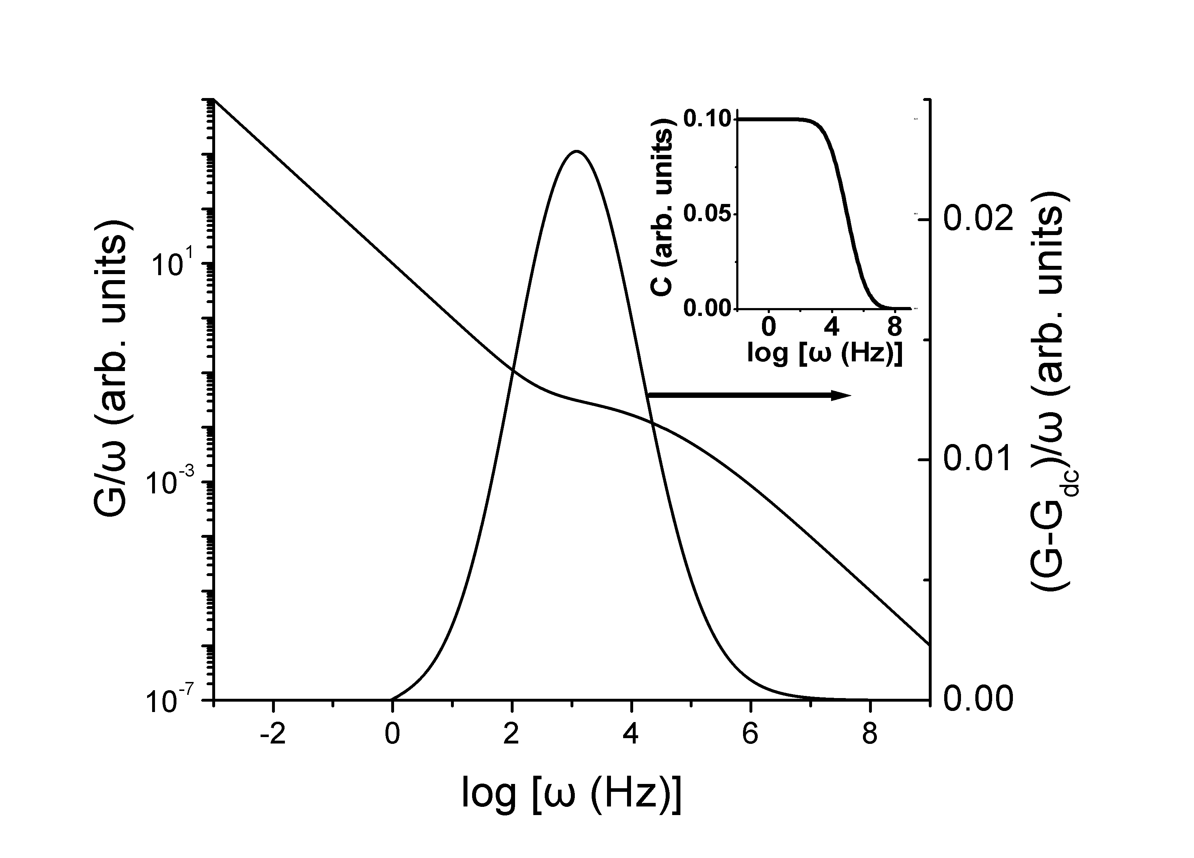
Normal distribution of log-L’s
υ=Lω

Slide 24
ELECTRIC (or DIELECTRIC MODULUS M*(ω)

Slide 25
If the dc conductivity mechanism co-exists with a dielectric relaxation mechanism
τ_{d}=(M_{s}/M∞⁾τ_{ε}.

Slide 26
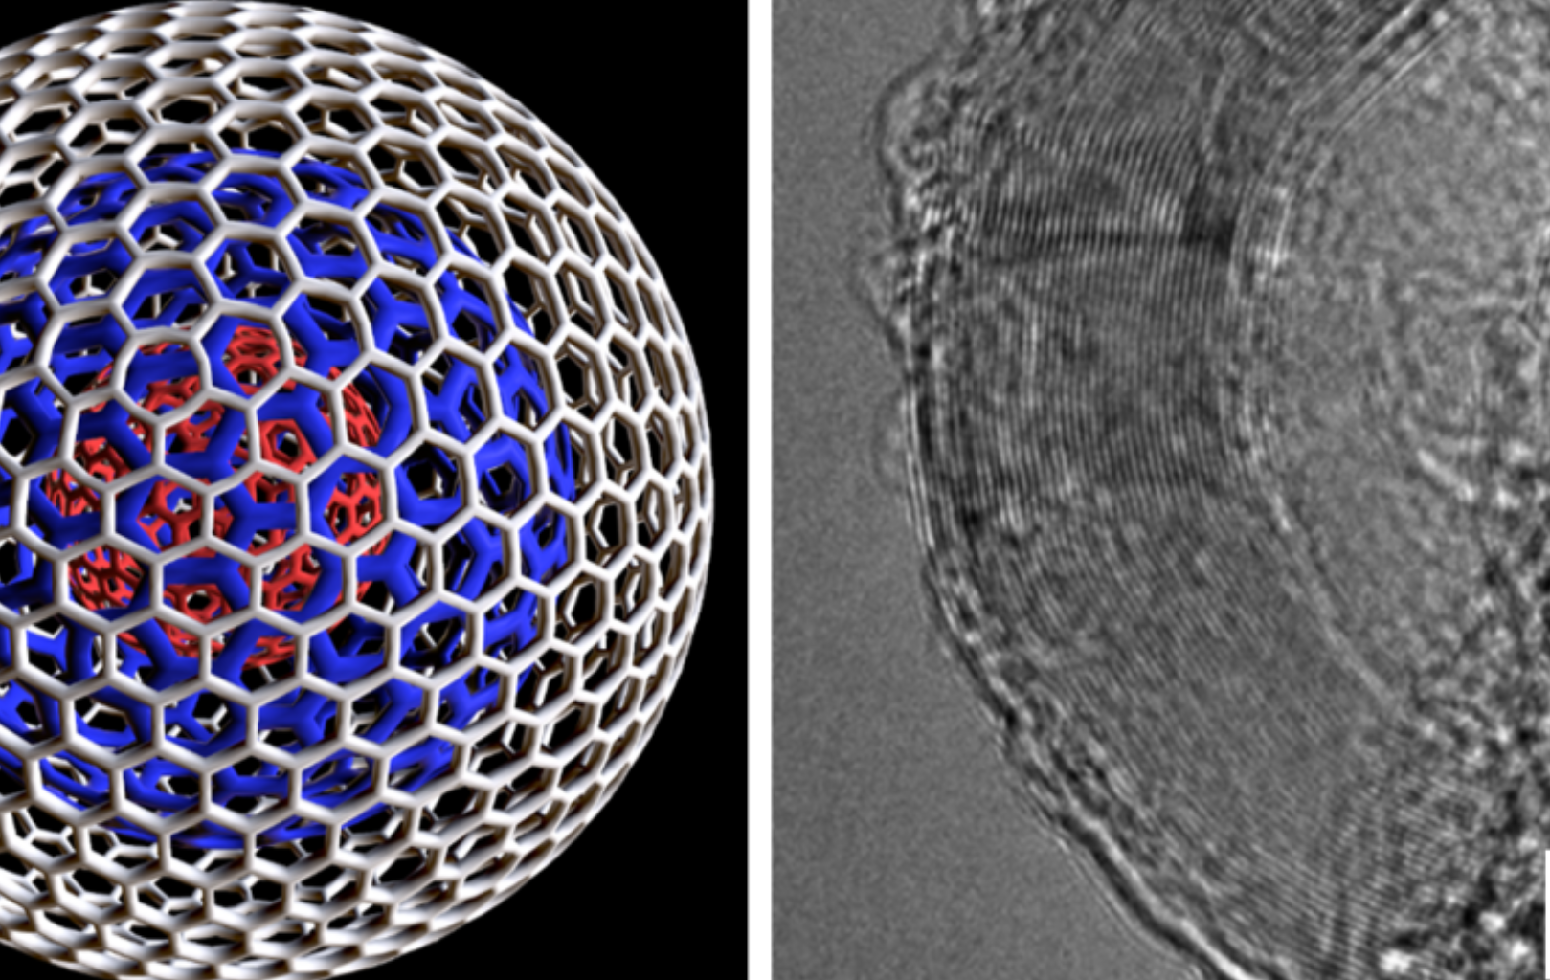
Application:
Polynanile: Carbon Nano-Onions (PANI/CNO composites)
ΨΝ

Slide 27
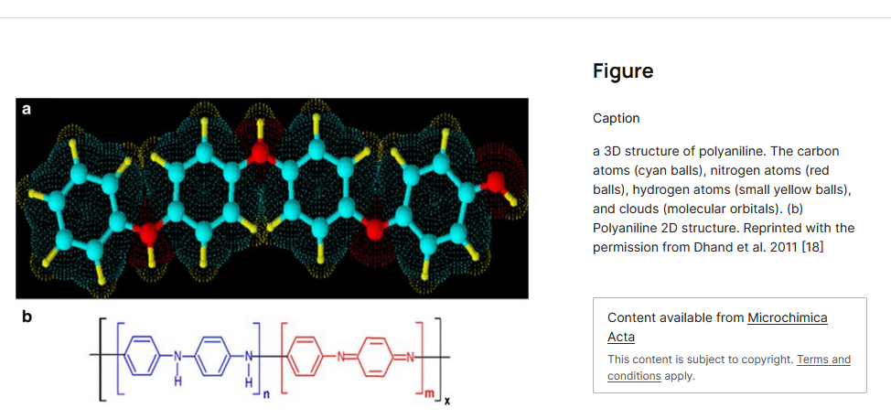
Reversible dopping:
Oxidatuion by HCL → H+ (polarons)

Slide 28
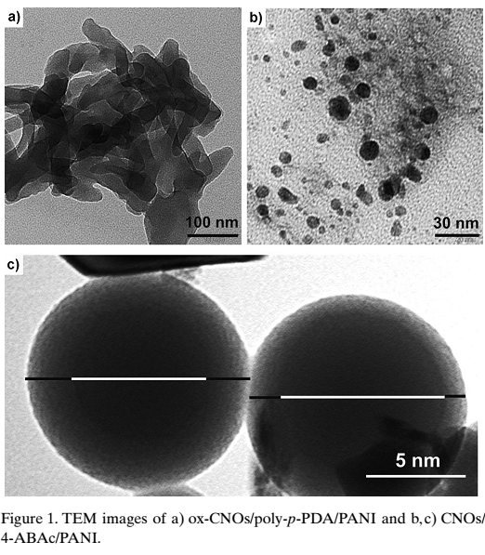
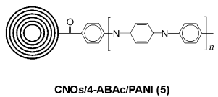
Dielectric relaxation peak:
α=inverse localization length (1/radius of H⁺ wave-function)
R=typical dimension of the regieon wherein trapped H⁺ relax
Transition Rate Theory:
Linear fit to lnf_{o}(1/kT) data points:

